Slide 1
Unit 2
Planning Process and Types of Plans

Slide 2
Learning Outcomes
After this lecture students will be able to
Conceptualize the Planning process
Differentiate between the Types of Plans
Craft Plans as per contingent requirements
Establish the relation between Planning and Controlling

Slide 3
21st Century : An era of Dynamic Engagement
Dynamic Engagement : Successful management emphasizes human relationships and rapid adaptation to changing conditions !
Example : Reliance Jio , Microsoft , Google – Digital Transformation and affecting the societal lifestyle

Slide 4
Concept of Planning
Primary of all managerial functions as it involves deciding of future course of action.
Planning involves defining the organization’s goals, establishing overall strategy for achieving goals, and developing a comprehensive set of plans to integrate, coordinate organizational work

Slide 5
Case Study- Organizational Planning
Boeing called its new 787 aircraft the Dreamliner, but the project turned into more of a nightmare for managers.
The new plane was the company’s most popular product ever, mostly because of its innovations, especially in fuel efficiency. However, the plane was two and a half years behind schedule.
Boeing admitted that the project’s timeline was way too ambitious even though every detail had been meticulously planned.

Slide 6
Organizational Planning
Some customers (the airlines who ordered the jets)—around 60 in total—got tired of waiting or responded to the changing economic environment and canceled their orders.
Question for Discussion
Could Boeing’s managers have planned better?

Slide 7
Characteristics of Planning
Planning involves defining the organization’s goals
Establishing strategies for achieving those goals
And developing plans to integrate and coordinate work activities.
It’s concerned with both ends (what) and means (how)

Slide 8
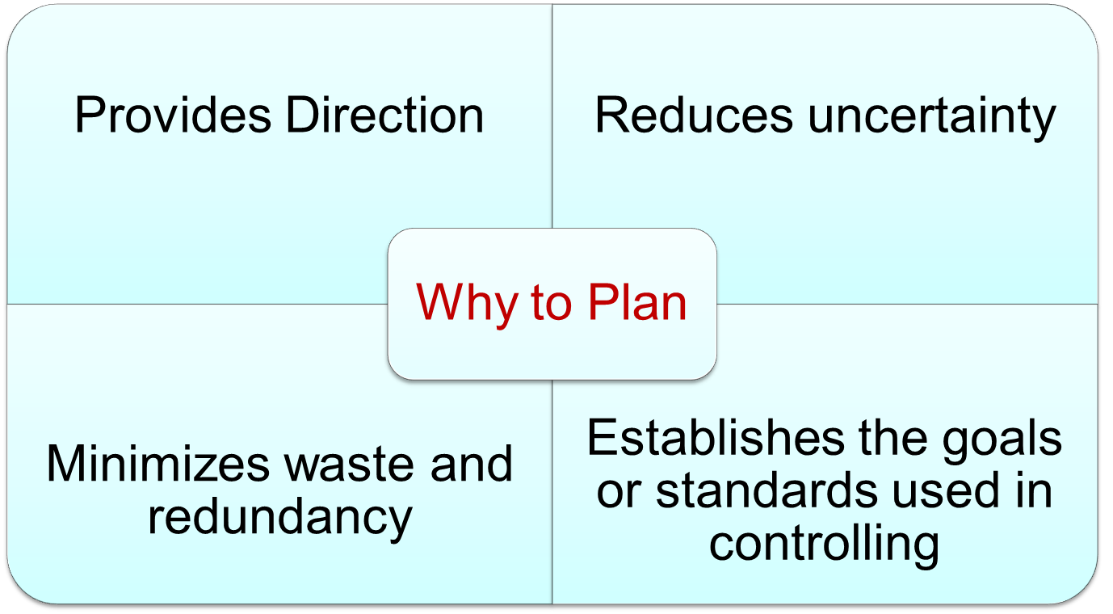
Benefits of Organizational Planning ?

Slide 9
Let’s check your understanding
1. Name the function of management which involves setting objectives and developing appropriate courses of action to achieve these objectives:
(a) Directing
(b) Organizing
(c) Planning
(d) Staffing

Slide 10
Planning Process
About half of all new businesses survive 5 years or more and one –third survive 10 years or more
        U.S Bureau of Labor Statistics “Entrepreneurship and U.S Economy”

Slide 11
Planning Process
Goal Setting
  Refer the Organization’s Mission
  Evaluate Available Resources
  Determine Goals individually or with inputs from others
  Write Down the Goals and Communicate to all concerned
  Review Results whether goals are being met

Slide 12
Planning Process
3 Contingency Factors in Planning
  Organizational Level
  Environmental Uncertainty
  Length of Future Commitments

Slide 13
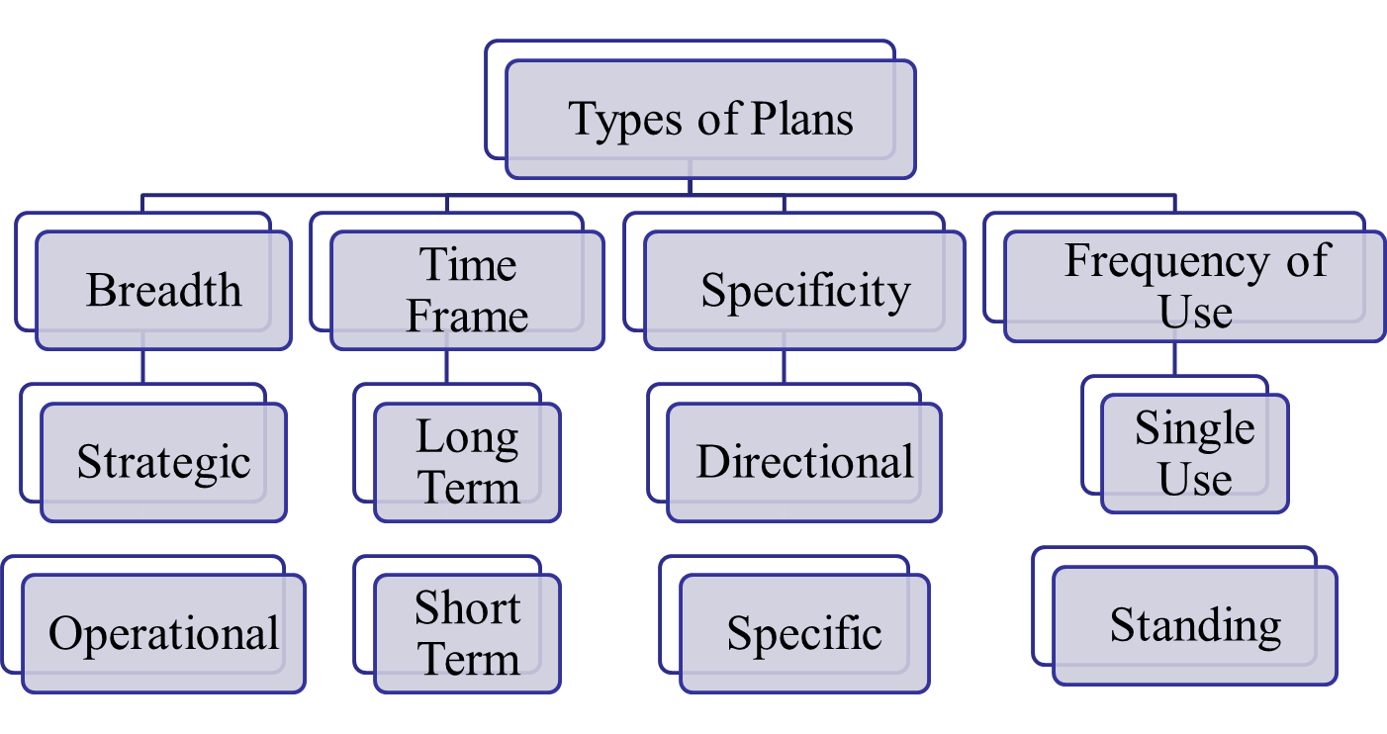
Types of Organizational Plans

Slide 14
Strategic Plans
Apply to the entire Organization’s and establish the organization’s overall goals.
What is the Strategic Plan of Reliance Group?
Reliance Strategy
Notes:
https://www.ril.com/ar2015-16/strategic-framework-and-outcome.html#:~:text=Strategy&text=Reliance%20is%20pursuing%20its%20strategy,and%20those%20of%20the%20future.

Slide 15
Strategic Planning at Corporate level
Corporate-level executives primarily focus on the questions such as:
RELIANCE GROUP ::
What industries should we get into?
What markets should the firm be in?
In which businesses should the corporation invest money?
What resources should be allocated to each business?
RIL Business

Slide 16
Strategic Planning at Strategic Business Unit (SBU) level
At this level managers focus on determining how they are going to compete effectively in market and address questions such as:
RELIANCE JIO ::
Who are our direct competitors?
What are their strengths and weaknesses?
What are our strengths and Weaknesses?
What advantages do we have over competitors?

Slide 17
Operational Plan at Wal-Mart
Wal-Mart’s “cross-docking” technique for inventory replenishment address what happens today, tomorrow and next week.
Goods are continuously delivered to Wal-Mart warehouses where they are selected, repacked and sent to individual stores within 48 hours.
Outcome- Operational Plan allows Wal-Mart employees to achieve economies of scale for large purchases without suffering the usual higher inventory costs.

Slide 18
Test your understanding!!
2. Which of the following statements is FALSE with reference to planning?
(a) Planning is a pre-requisite for controlling.
(b) Planning does not lead to rigidity.
(c) Planning enables a manager to look ahead and anticipate changes.
(d) Planning facilitates co-ordination among departments and individuals in the organization.

Slide 19
Unit 2 :
CONTROLLING ::
CASE DISCUSSION ON TIBERG COMPANY

Slide 20
Learning Outcome
Establish the relationship between planning and controlling
Understand concept of organizing in practical application

Slide 21
The Control Process
When Maggine Fuentes joined Core Systems in Painesville, Ohio, as HR manager, she knew that her top priority was reducing employee injuries.
The number of injuries was “through the roof; above the industry average.” The high frequency and severity of the company’s injury rates not only affected employee morale but also resulted in lost workdays and affected the bottom line.
Maggine relied on the control process to turn this situation around.

Slide 22
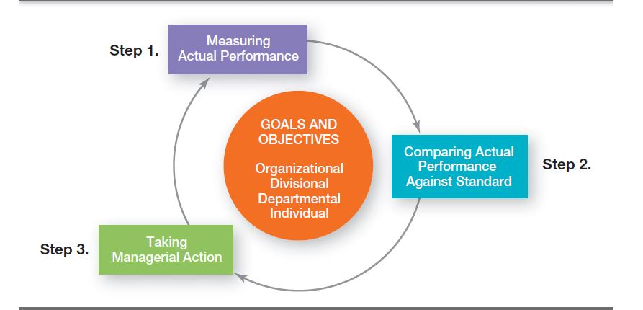
Process of Controlling

Slide 23
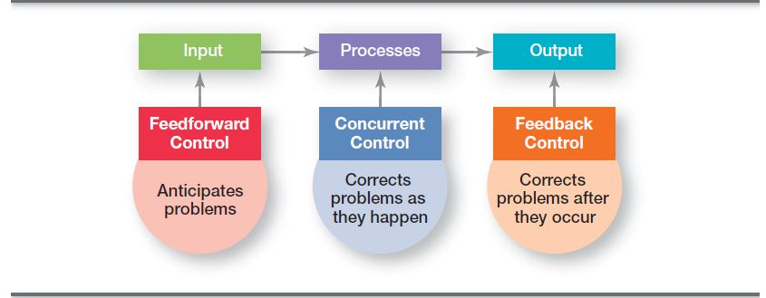
Types of Control

Slide 24
Unit 2
Managerial Functions
#Decision making

Slide 25
Learning Outcomes
  Experiential learning of Decision making : Case Corporate Purchase Decision

Slide 26
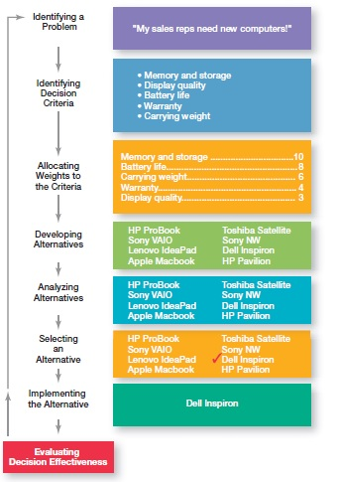
Decision Making

Slide 27

Case : Corporate Purchase Decision
Amanda is a Purchase manager whose sales reps need new laptops because their old ones are outdated and inadequate for doing their job.
To make it simple, assume it’s not economical to add memory to the old computers and it’s the company’s policy to purchase, not lease.
Amanda has a decision to make.

Slide 28
Step 1 : Identify the problem
Now we have a problem—a disparity between the sales reps’ current computers (existing condition) and their need to have more efficient ones (desired condition).

Slide 29
Unit 2
Introduction to Organizational Behaviour

Slide 30
Learning Outcomes
Understand Organizational Behaviour Model
Contributing disciplines towards the field of OB

Slide 31
News Discussion
India Power Corporation Ltd to expand operations
- Economic Times, September 16th, 2020

Slide 32
Defining Organizational Behaviour
A field of study that investigates the impact that individuals, groups and structure have on behaviour within organizations, for the purpose of applying such knowledge toward improving an organization’s effectiveness.

Slide 33

What do you see in picture?

Slide 34
Factors influencing Organizational Behaviour
Broad Factor | Sub Factor
Social | Leadership styles, co worker personalities, group dynamics, relationships
Environment | Lighting, aesthetics, office/desk set-up
Structure | Employee hierarchy, organizational structure of departments in business units
Tools | Access to information, tools and technology
Processes | Workflow management, reporting structures, project management styles

Slide 35
Practice Question
Q- How is management theory connected to organizational behaviour?
There is no connection between management theory and organizational behaviour
Organizational behaviour helped to develop management theory
Management theory established the foundation for organizational behaviour
The same theorist who developed management theory also created organizational behaviour

Slide 36
Example #1: Apple Inc.
Steve Jobs, Co-founder, Chairman, and CEO of Apple Inc. attributed the innovations at Apple, which include the iPod, MacBook, and iPhone, to people, noting, “Innovation has nothing to do with how many R&D dollars you have.
It’s not about money. It’s about the people you have, how you’re led, and how much you get it.

Slide 37
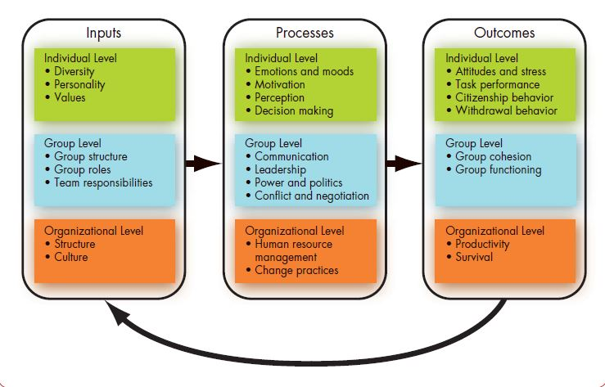
Organizational Behaviour Model

Slide 38
Step 2: Identifying Decision Criteria
Amanda decides after careful consideration that memory and storage capabilities, display quality, battery life, warranty, and carrying weight are the relevant criteria in her decision.

Slide 39
Step 3: Allocating Weights to the Criteria
If the relevant criteria aren’t equally important, the decision maker must weight the items in order to give them the correct priority in the decision.
How? A simple way is to give the most important criterion a weight of 10 and then assign weights to the rest using that standard.
Of course, you could use any number as the highest weight.
  Memory and storage : 10
  Battery life : 8
  Carrying weight : 6
  Warranty : 4
  Display quality : 3

Slide 40
Step 4: Developing Alternatives
HP ProBook
Sony VAIO
Lenovo IdeaPad
Apple Macbook
Toshiba Satellite
Sony NW
Dell Inspiron
HP Pavilion

Slide 41
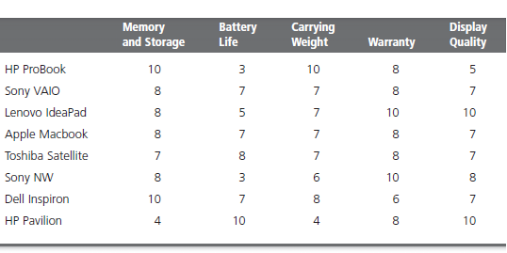
Step 5 a : Analyzing Alternatives

Slide 42
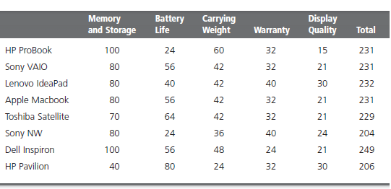
Step 5 b: Analyzing Alternatives

Slide 43
Step 6: Selecting an Alternative
Basis the analysis which alternative will you select ?

Slide 44
Step 7: Implementing the Alternative
Put the decision into action by conveying it to those affected and getting their commitment to it.
We know that if the people who must implement a decision participate in the process, they’re more likely to support it than if you just tell them what to do.
Review : case Tiberg company !
Reassess the environment for any changes, especially if it’s a long-term decision.
Are the criteria, alternatives, and choice still the best ones, or has the environment changed in such a way that we need to reevaluate?

Slide 45
Step 8: Evaluating Decision Effectiveness
Evaluating the outcome or result of the decision to see whether the problem was resolved.
  If the evaluation shows that the problem still exists, then the manager needs to assess what went wrong.
  Was the problem incorrectly defined?
  Were errors made when evaluating alternatives?
  Was the right alternative selected but poorly implemented?
The answers might lead you to redo an earlier step or might even require starting the whole process over

Slide 46
THANK YOU

Slide 47
Tiberg manufactures multiple types of equipment's.
20 Plants in 3 different locations in Europe and 1 in Asia
Purchasing operations across 20 plants were never coordinated

Slide 48
The head office always encouraged the offices across locations to operate as a separate independent unit in most matters.

Slide 49
What type of control of this?
Centralized or De-centralized

Slide 50
Late 1980
It started to appear, there will be long term difficulty in securing certain essential raw material.
CEO created a special position of VP-Purchasing and Mr. Porte an experienced executive was handed this task.

Slide 51
Mr. Manwell was made the Mr. Porte’s assistant, who knew many of the plant executives personally across 20 locations.
Mr. Manwell had spend minimum 4 years in all the countries where Tiberg plants were located.

Slide 52
First decision made by Mr. Porte was to centralize the company’s purchasing procedure.
It became mandatory for purchasing head in each plant to get approval from head office for any purchase order above $100,000.
A time period of minimum one week to be given to head office to decide before the purchase was to be made.
Board of directors approved this plan

Slide 53
Company plants used to make purchases through out the year. But the peak purchasing season was only 3 weeks away.
The new plan was adopted.

Slide 54
Mr. Porte prepared a letter to be sent to 20 purchasing executives of the company.

Slide 55
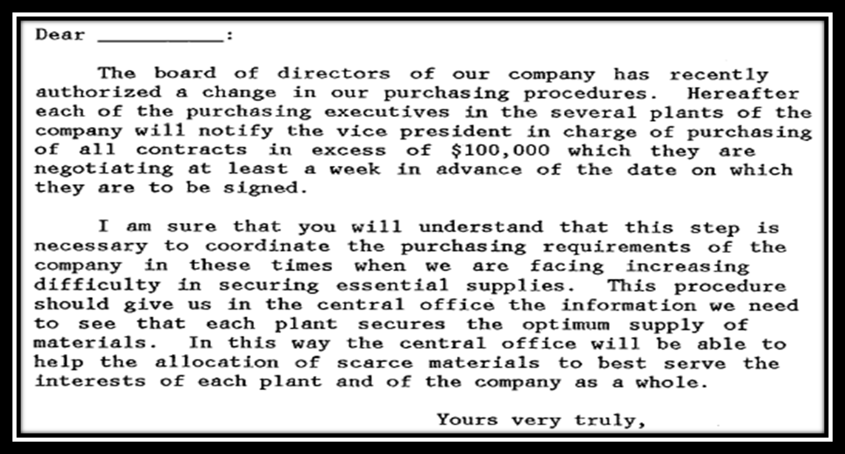

Slide 56
CEO liked the letter and told Mr. Porte to visit plants personally.
Mr. Porte denied the idea on grounds of being caught up in work at head office.

Slide 57
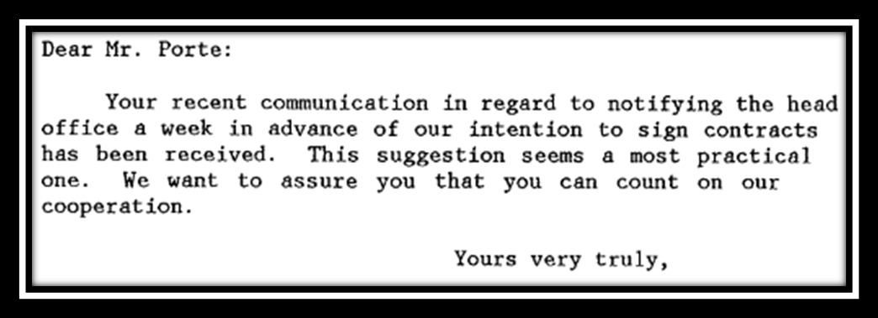
Letter forwarded to all 20 plants and some of the plant purchasing head replied as:

Slide 58
In the next six weeks, the head office received no new notices or purchase communication from any plant.
Executives in other department who made frequent trips to plants informed that Plants were busy and usual routines of the year were being followed.

Slide 59
What went wrong?
Was this way of controlling right?

Slide 60
Case Analysis
Problem Identification:
The purchasing procedures of all the plants were un-coordinated and decisions with respect to all purchases were made at individual plant level.
The predicament (difficult situation) arose when a shortage of essential raw materials was foreboded.
Action taken by Mr. Porte:
Mr. Porte decided to centralize the company’s purchasing procedure. Each purchasing executive in all plants of company would notify him of all contracts in excess of $1,00,000

Slide 61
Outcome of Mr. Porte’s actions:
The peak season that followed soon saw no notices from any plant regarding any contracts being negotiated.
Key Problems:
Assumption that communication has taken place
In the letters sent to the purchasing executives of the company, Mr. Porte uses an authoritative tone. This became counterproductive when requiring employee cooperation.
In the letter, he addresses himself in third person which makes his position sound domineering
He did not see meeting the plant heads as an essential pre-requisite. It was impprtant to have dialogue and questions.

Slide 62
Points for Recommendations
Mr. Porte when writing the letter should use a tone that is related to someone leading the process of change rather than forcing it
In the letter, the situation of the company should be stated and then mentioning the change which is intended to bring to solve the difficulty
Appropriate words that are suited to a formal context of addressing employees and subordinates should be used in letter.
Mr. Porte should know the present working culture of company and brings about the change in gradual manner with taking steps like establishing a rapport and considering feedback on the change intended.

Slide 63
Agile Organization
Food producer and distributor Cargill Inc in 2012 found it was failing to engage and motivate its 1,55,000 employees worldwide
Cargill decided to become an agile organization wherein they focused on major principles:
Feedback need to be continuous, rather than document heavy and sporadic
Relationship between employee and manager is paramount
System needs to remain flexible and agile to meet business needs

